Slide 1


Predicting customer buying Behaviour

Slide 2
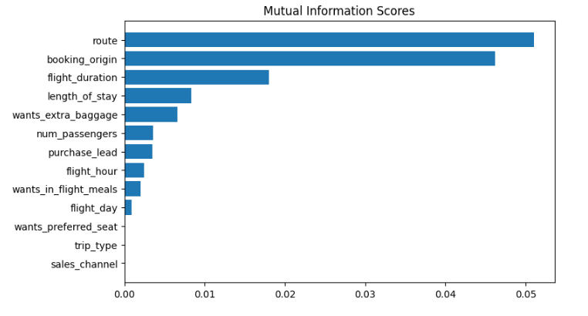
predictive model to understand factors that influence buying behaviour
We have trained the data set with Random forest classifier model and received
ACCURACY: 85.09
AUC score: 0.558
route
Booking origin
Flight duration
Wants extra baggage
Length of stay
are the top 5 features which influence
Customer buying behavior
We need to increase the AUC score.

